Slide 1
MODELING AND KEY TECHNOLOGIES OF A DATA-DRIVEN SMART CITY SYSTEM
AWH22MCA-2045
VARNA VINOD
GUIDE: MRS.SRUTI SUDEVAN

Slide 2
INTRODUCTION
Evolution of City Functionality.
Smart cities generate valuable data.
Middleware serves as a bridge between data collection and smart city applications.
Need for key technologies and practices.
Solutions include a top-level design model and key technologies for effective city management.

Slide 3
FEATURES OF SMART CITY OPERATION AND MANAGEMENT CENTER
Numerous computers ,work stations and data collection.
Large screen for data visualization.
Transfer raw data collected from sensors and historical database to conclusion.
Decision-making through data analysis.

Slide 4
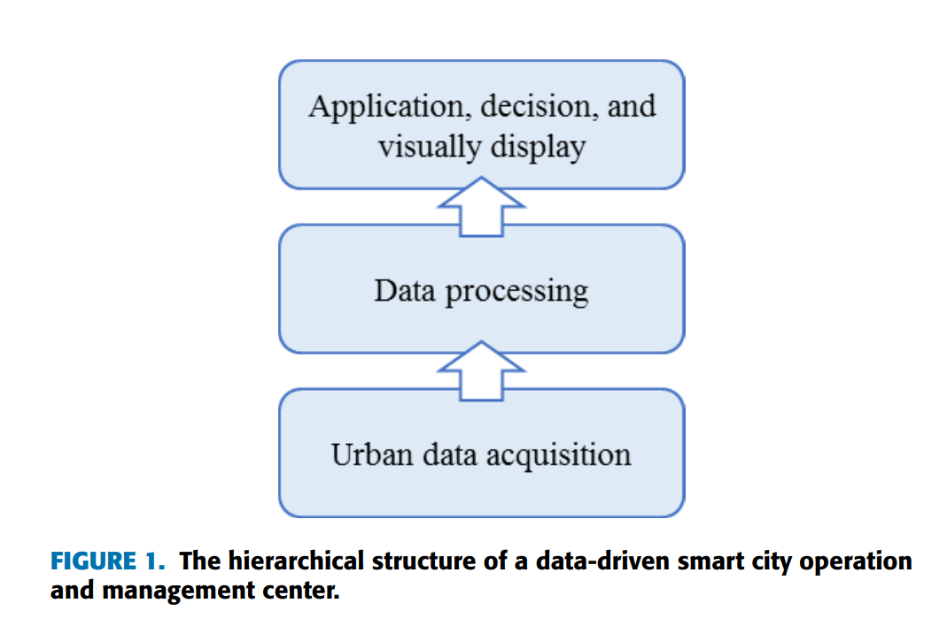
HIERARCHICAL STRUCTURE OF SMART CITY OPERATION
AND MANAGEMENT CENTER

Slide 5
EXISTING WEAKNESS OF SMART CITY OPERATION
AND MANAGEMENT CENTER
1. TOP LEVEL DESIGN THEORY IS INCOMPLETE
Pay more attention technical side than management and operations.
Smart city applications are designed as separate tools.
Lack of coordination.
Affects daily operations.
Should be strengthened and interoperations need to be considered.

Slide 6
2. INTEGRATION ABILITY OF HARDWARE AND SOFTWARE IS INSUFFIECIENT
Focus on different city services rather than building a strong foundation.
Create standard ways for data collection and access.
Need to build a platform that gathers, analyzes, and processes data from different sources.
Provide security in Data Handling.

Slide 7
3.DATA COLLECTION AND COMPUTING ARE NOT EFFICIENT ENOUGH
Expansion of data collection.
Shifting from simple sensors to multiple sources.
Need a way to store structured and unstructured data.
Transformational Insights.
To improve we can use AI to filter valuable information.

Slide 8
4.DATA ANALYSIS AND APPLICATION ARE NOT INTELLIGENT ENOUGH
Everyone should be able to create, contribute, use, and evaluate data.
Meaningful Information Extraction from collected data.
Should find patterns, make rules, and use expert knowledge to create smart models.
Turn raw data into something really smart that helps us analyze, simulate, and make decisions.

Slide 9
TOP-LEVEL DESIGN MODELING AND OPERATIONAL PATTERN
1.METHODS
Massive, complex system with many elements and applications.
Understanding coordination between different parts in important.
First gather ideas from existing literature.
Create a model or plan for how a smart city should operate to be sustainable.
Real City Application.

Slide 10
2.ANALYSIS OF CONCEPTUAL FRAMEWORK
KEY DOMAINS
Economy : Focuses on economic activities, business development.
People : Concentrates on the well-being and education
Government: Improving governance, and citizen-government interactions.
Environment: Addresses sustainability environmental conservation
Living : Enhances the overall living experience including aspects like safety, security, and community.

Slide 11
DESIGN PRINCIPLES
Need to balance technology with existing systems for success.
It's not just about technology; involving the public and stakeholders is crucial.
Collaboration between social and technological aspects is key for innovation.
Establishing clear rules prevents redundancy and promotes cooperation.
Focus on resource integration and stakeholder collaboration.

Slide 12
3.TOP LEVEL DESIGN MODEL
Two dimension , Three-layer and six-goal
Coordinate from two perspectives - technology implementation and policy mechanisms.
Design model is structured into three layers for comprehensive coverage.
Model sets six principles to guide the operational pattern of a smart city.
Achieve efficient governance through seamless data integration, coordinated policies.

Slide 13
TWO DIMENSIONS
Technical Implementation:
Policy Mechanism:
Make sure that technology part runs without problems.
Breaks down barriers and connects everything like a network.
Rules and plans that help everything work smoothly.
Solves problems like systems not working well together.

Slide 14
THREE LAYERS
Smart Infrastructure Layer:
Responsible for the collection, transmission, and storage of data.
Smart Brain Layer:
Dedicated to managing, processing, and integrating the collected data.
Smart Application Layer:
Delivers specific solutions and applications.

Slide 15
SIX GOAL
Intelligent infrastructure.
Convenient public services.
Refined social governance.
Livable living environment.
Sustainable network security.
Modernized industrial development.

Slide 16
OPERATIONAL PATTERN
Coordination mechanism led by a city's main leaders.
Data resource system for collection and sharing.
Designing a unified standard data interface to extend application systems.
Real-time Visualization of city status.
Application portal for smart services for residents.

Slide 17
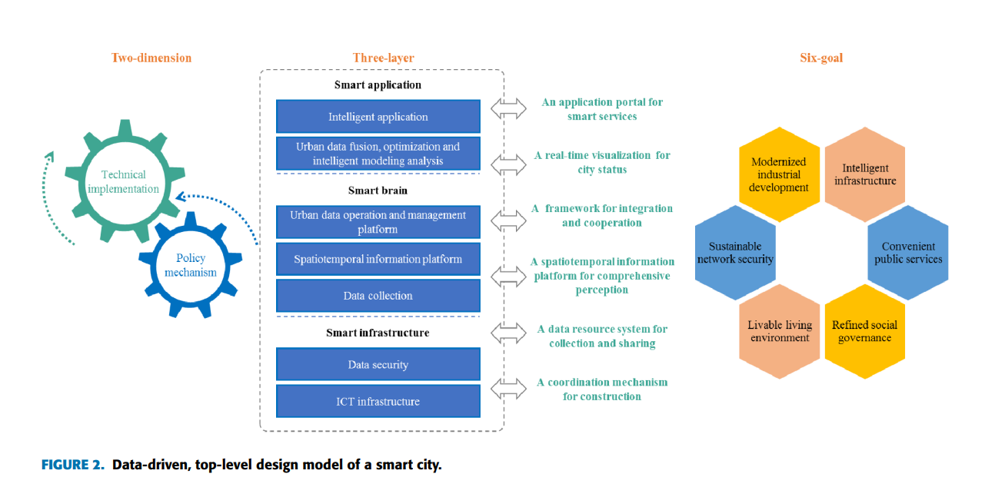

Slide 18
KEY TECHNOLOGIES OF SMART CITY OPERATION MANAGEMENT CENTER
New-Generation ICT Infrastructure for Smart City:
Fixing issues in setting up networks and keeping things secure.
Urban Data Perception, Multidimensional Data Collection, and Data Fusion Technology:
A central hub, that organizes different types of data.
Intelligent Analysis and Service Technology of Urban Data:
Approvals and efficient handling of government affairs.

Slide 19
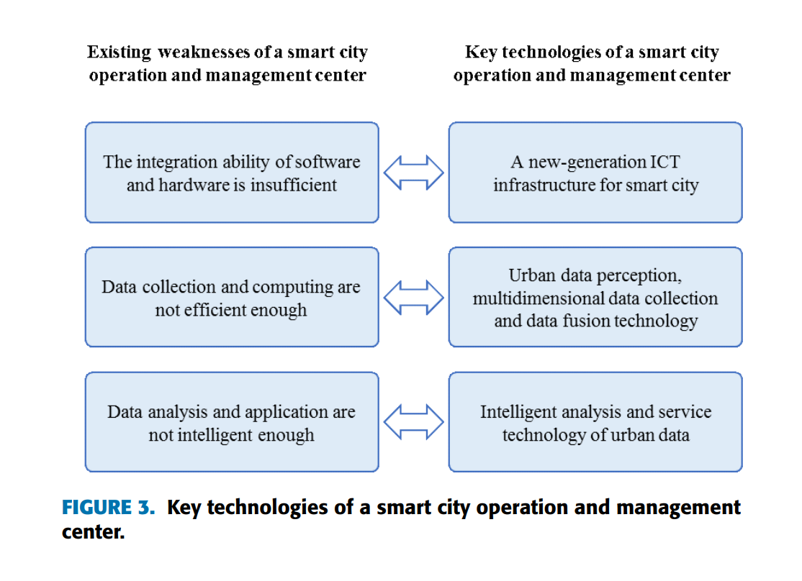
KEY TECHNOLOGIES OF SMART CITY OPERATION MANAGEMENT CENTER

Slide 20
PRACTICAL CASE OF A SMART CITY OPERATION AND MANAGEMENT CENTER
Streamlined coordination among multiple government departments, enhancing the overall governance structure.
Data-driven decision-making through comprehensive data collection and analysis.
Efficient management of various aspects, including safety, environmental issues, education, healthcare, and more.

Slide 21
CONCLUSION
Addressing both technical and managerial aspects, emphasizing the need for a comprehensive top-level design theory.
Recognizing the limitations in current models, the research highlights the need for increased integration capabilities.
Emphasizing the transformation of raw data into actionable knowledge for effective urban governance.

Slide 22
THANK YOU

